Slide 1
Employee Performance Analysis Using Excel
PRESENTED BY: SANGEETHA G
REGISTER NO.: 312204623
DEPARTMENT: COMMERCE
COLLEGE: K.C.S KASI NADAR COLLEGE OF ARTS AND SCIENCE

Slide 2
PROJECT TITLE
Employee Performance Analysis Using Excel

Slide 3
AGENDA
1.Problem Statement
2. Project Overview
3.End Users
4.Our Solution and Proposition
5. Dataset Description
6. Modelling Approach
7. Results and Discussion
8.Conclusion

Slide 4
PROBLEM STATEMENT
The data shows varying performance scores and ratings among employees in similar roles (e.g., Area Sales Managers), which could indicate inconsistent evaluation criteria or management practices.There is a mix of employee statuses (Active, Temporary, Contract) which may impact job stability and employee satisfaction.
Employees have different classifications and employment types (Full-Time, Part-Time, Contract, Temporary) which can affect workload distribution and team dynamics.
The employee ratings range from 1 to 5, suggesting potential inconsistencies in how performance is assessed across departments or business units.There are variations in gender, race, and other demographics that could influence performance and job satisfaction but may not be adequately addressed.

Slide 5
PROJECT OVERVIEW
[Employee Performance Improvement and Pay Zone Optimization]
To analyze performance discrepancies and identify factors contributing to varying performance scores and ratings among Area Sales Managers. To analyze performance discrepancies and identify factors contributing to varying performance scores and ratings among Area Sales Managers.
Investigate the evaluation criteria and methods used for performance ratings to ensure consistency and fairness across different managers and departments. Assess how different employment statuses (e.g., Full-Time vs. Part-Time) affect employee performance and overall team efficiency. Explore how demographic factors (e.g., gender, race) impact performance ratings and if any biases are present.
Develop recommendations for improving performance evaluation processes, addressing potential biases, and standardizing criteria to enhance overall employee satisfaction and performance consistency.

Slide 6
WHO ARE THE END USERS?
Human Resources (HR) Department
Department Managers (Sales & Production)
Senior Leadership/Executives
Employees
Finance/Compensation Teams

Slide 7
OUR SOLUTION AND ITS VALUE PROPOSITION
FILTERING - Remove missing values.
CONDITIONAL FORMATTING - Blanks, Background Color Shading, Data Bars, Values.
DATA FILTERING AND SORTING - Identify specific employee performance groups, such as those with exceeds, needs improvement and fully meets.
PIVOT TABLE - Summary of employee performance under their employee Id.
GRAPHS - Final Report with Trend line.

Slide 8
DATASET DESCRIPTION
EMPLOYEE ID: Unique identifier for each employee in the organization.
FIRST NAME: The first name of the employee.
CURRENT EMPLOYEE RATING: The current rating or evaluation of the employee's overall performance
PERFORMANCE SCORE: A score indicating the employee's performance level (e.g., Excellent, Satisfactory, Needs Improvement).
BUSINESS UNIT: The specific business unit or department to which the employee belongs

Slide 9
MODELLING
DATA SET: Kaggle, Employee dataset.
FEATURE SELECTION: Slicer, Conditional Formatting, Designing.
DATA CLEANING: Missing values, Irrelevant data, Correct Errors, Remove Unnecessary Columns and Rows.
PIVOT TABLE: Employee ID, First Name, Performance Score, Business Unit, Current Employee Rating.
CHART: Report of Employee Performance based on their Employee Id is represent in Values and Performance Score presented as Column Chart.

Slide 10

RESULTS

Slide 11
CONCLUSION
The analysis revealed significant performance discrepancies among employees in similar roles, indicating potential issues with the evaluation process or management practices.
Variations in employee type and status were found to influence performance ratings and job satisfaction, suggesting a need for tailored performance management strategies.
Inconsistencies in performance ratings point to the need for standardized evaluation criteria and more transparent performance assessment methods.
Key areas for improvement include refining performance evaluation criteria, enhancing fairness in ratings, and addressing any discrepancies caused by employment status or demographic factors.
Implement the recommendations to improve performance management practices, monitor the impact of changes, and continuously assess and adjust strategies to foster a fair and productive work environment.

Slide 12
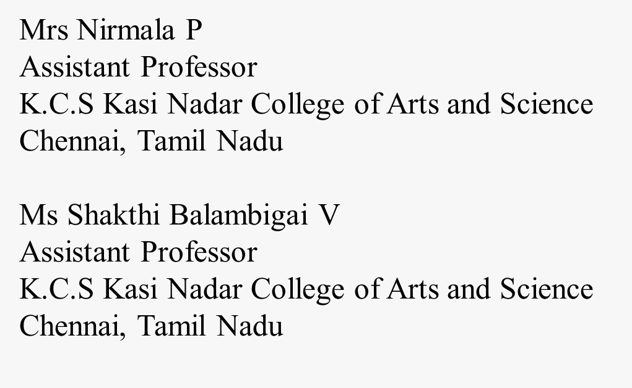
REFERENCE

